Slide 1





Aparna Radhakrishnan¹,Ryan Abernathey⁶, Sasha Ames¹⁰, V. Balaji⁴, Julius Busecke⁵, Forrest Hoffman¹⁰, Phil Kershaw⁷, David Neelin⁸, Jessica Liptak², John Krasting², Kristopher Rand³, Ag Stephens⁷, Hans Vahlenkamp⁹
American Geophysical Union 2023
Session: CF and NetCDF: 30 Years of Wide Open Science
1
Notes:
Pangeo is first and foremost a community promoting open, reproducible, and scalable science. The software ecosystem involves open source tools

Slide 2
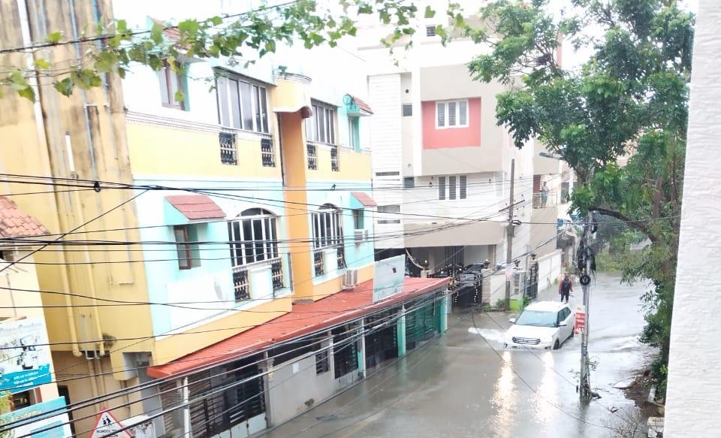
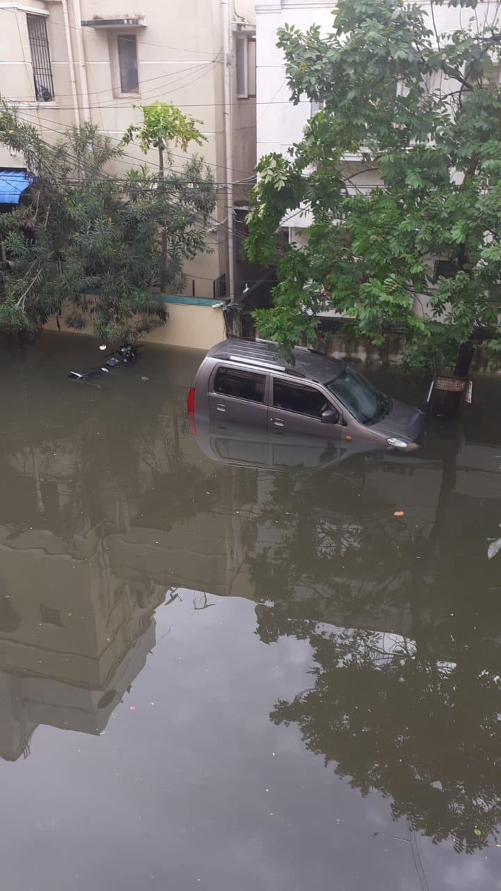
Every fraction of a degree of warming has grave consequences.
IPCC
Cyclone Michaung, Chennai, India.
Dec 5th, 2023
P.C. Srinivas
Acknowledging the Climate and Forecast conventions, A.Radhakrishnan et al AGU 2023
2

Slide 3
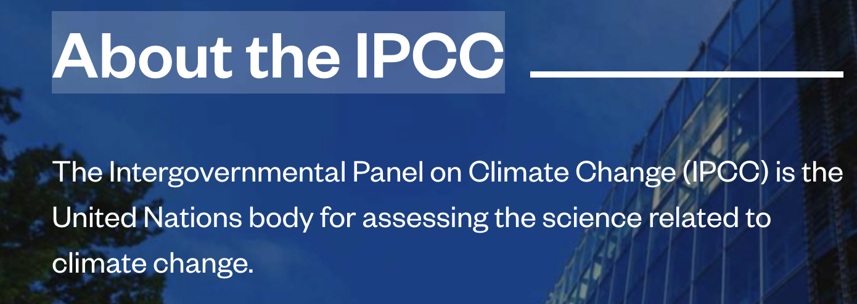
Every fraction of a degree of warming has grave consequences.
IPCC
Cyclone Michaung, Chennai, India.
Dec 5th, 2023
Acknowledging the Climate and Forecast conventions, A.Radhakrishnan et al AGU 2023
3

Slide 4
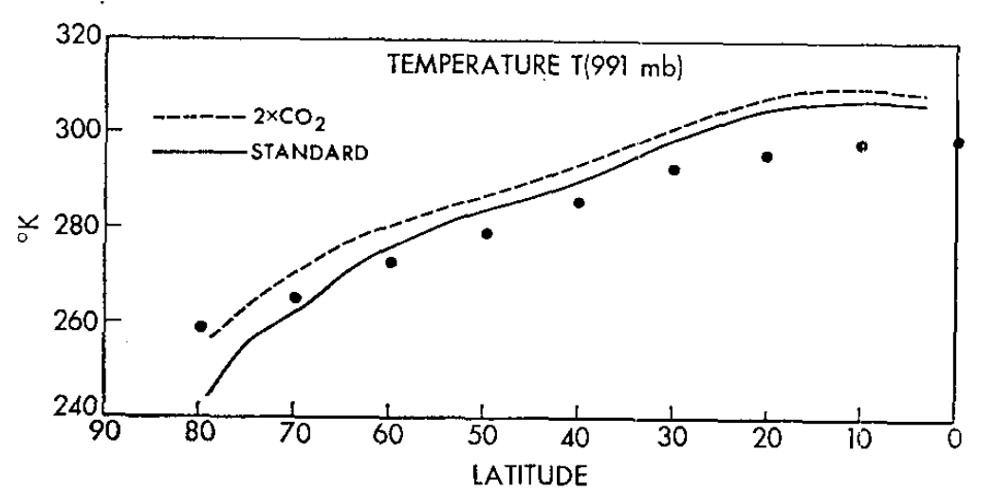
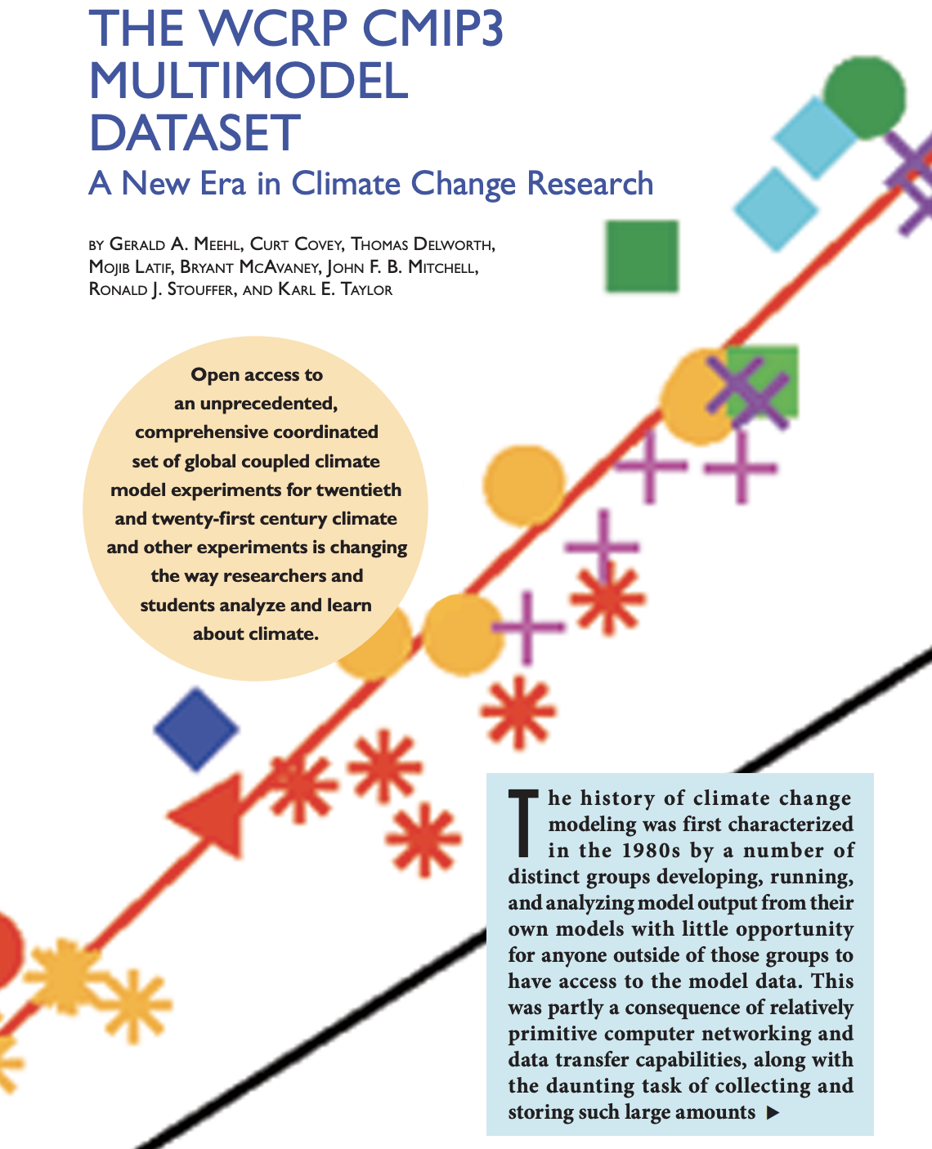
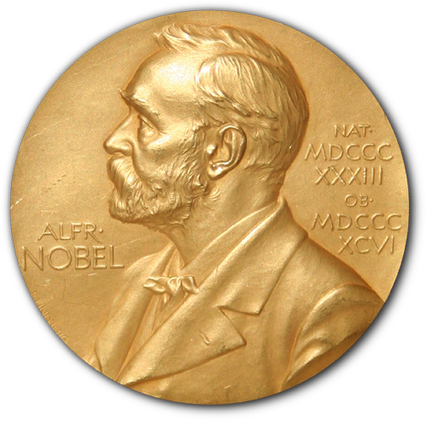
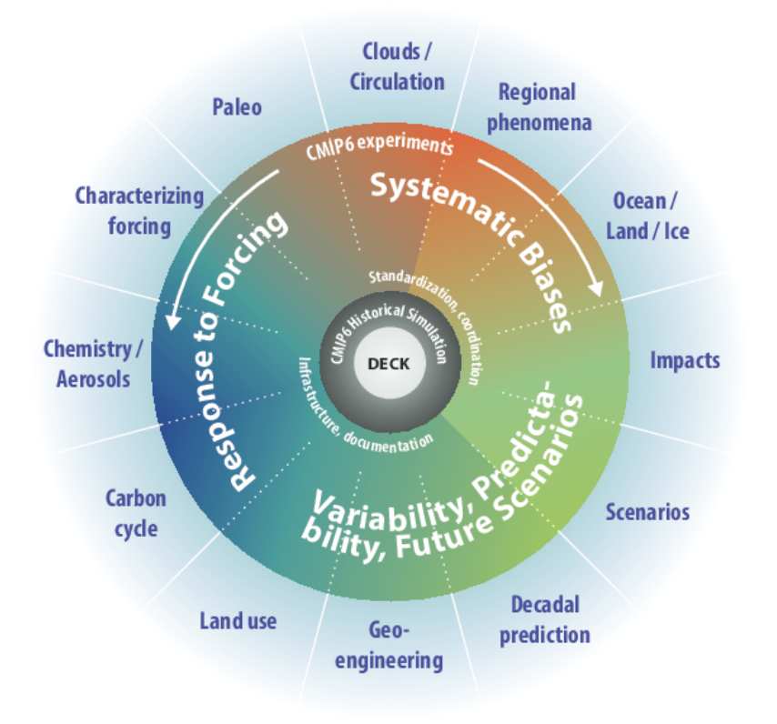
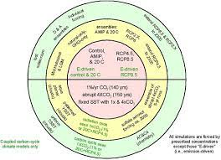
2007
Manabe, Wetherald
1975
Open access to an unprecedented, comprehensive coordinated set of global coupled climate model experiments for 20th and 21st century climate and other experiments is changing the way researchers and students analyze and learn about climate
3 models in Charney’s report
≈ 25 models all over the world
CMIP6 design, 2016
CMIP5 design,2012
≈ 120 models
≈ 60 models
Acknowledging the Climate and Forecast conventions, A.Radhakrishnan et al AGU 2023
4
≈ 25 models all over the world
Notes:
(NOAA GFDL)+ 2 (NASA GISS (Charney’s report, 1979)

Slide 5
2007
Manabe, Wetherald
1975
Open access to an unprecedented, comprehensive coordinated set of global coupled climate model experiments for 20th and 21st century climate and other experiments is changing the way researchers and students analyze and learn about climate
3 models in Charney’s report
≈ 25 models all over the world
CMIP6 design, 2016
CMIP5 design,2012
≈ 120 models
≈ 60 models
Acknowledging the Climate and Forecast conventions, A.Radhakrishnan et al AGU 2023
4
≈ 25 models all over the world
Notes:
(NOAA GFDL)+ 2 (NASA GISS (Charney’s report, 1979)

Slide 6
2007
Manabe, Wetherald
1975
Open access to an unprecedented, comprehensive coordinated set of global coupled climate model experiments for 20th and 21st century climate and other experiments is changing the way researchers and students analyze and learn about climate
3 models in Charney’s report
≈ 25 models all over the world
CMIP6 design, 2016
CMIP5 design,2012
≈ 120 models
≈ 60 models
Acknowledging the Climate and Forecast conventions, A.Radhakrishnan et al AGU 2023
4
≈ 25 models all over the world
Notes:
(NOAA GFDL)+ 2 (NASA GISS (Charney’s report, 1979)

Slide 7
2007
Manabe, Wetherald
1975
Open access to an unprecedented, comprehensive coordinated set of global coupled climate model experiments for 20th and 21st century climate and other experiments is changing the way researchers and students analyze and learn about climate
3 models in Charney’s report
≈ 25 models all over the world
CMIP6 design, 2016
CMIP5 design,2012
≈ 120 models
≈ 60 models
Acknowledging the Climate and Forecast conventions, A.Radhakrishnan et al AGU 2023
4
≈ 25 models all over the world
Notes:
(NOAA GFDL)+ 2 (NASA GISS (Charney’s report, 1979)

Slide 8
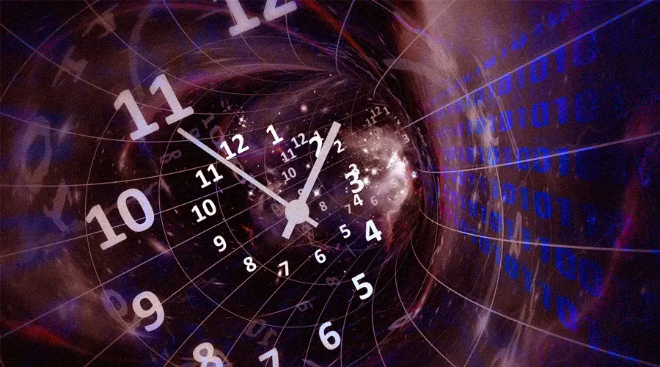
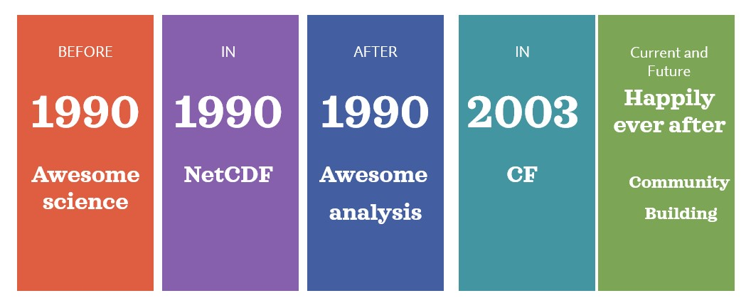
Acknowledging the Climate and Forecast conventions
Acknowledging the Climate and Forecast conventions, A.Radhakrishnan et al AGU 2023
5

Slide 9

GFDL climate modeling workflow
Data/Metadata standardization efforts
Community diagnostics
GFDL user analysis suites
Community diagnostics
Usable
Climate model output
CF and Climate Model Output Rewriter
GFDL Model Development
Provenance
Data publication
Towards interoperable tools and science
Acknowledging the Climate and Forecast conventions, A.Radhakrishnan et al AGU 2023
6

Slide 10
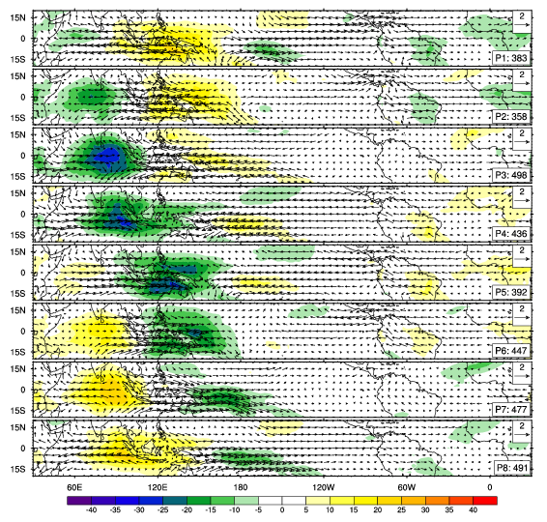
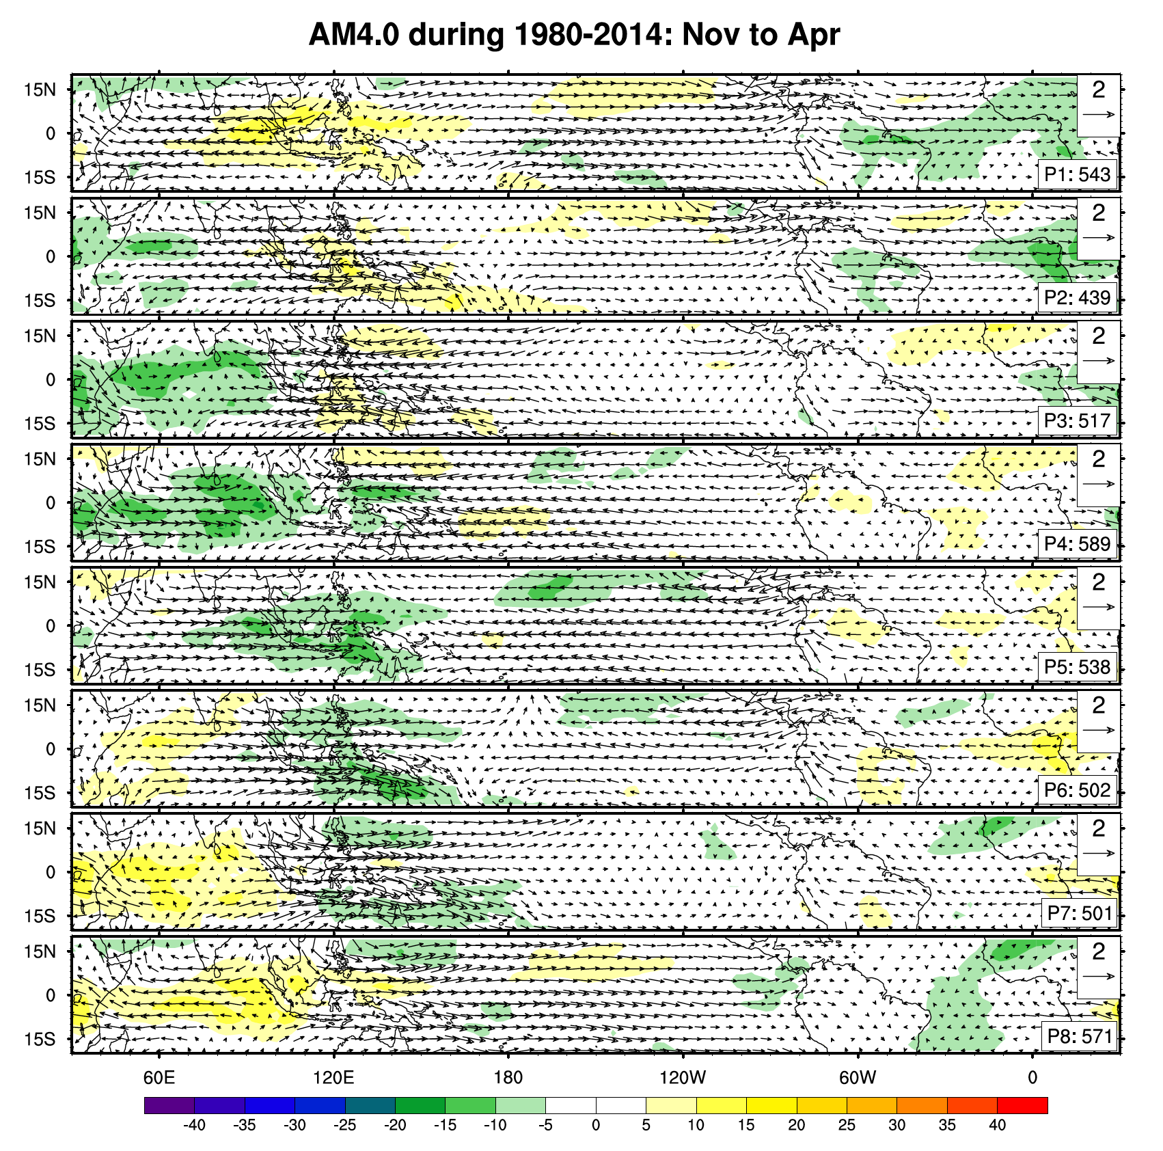
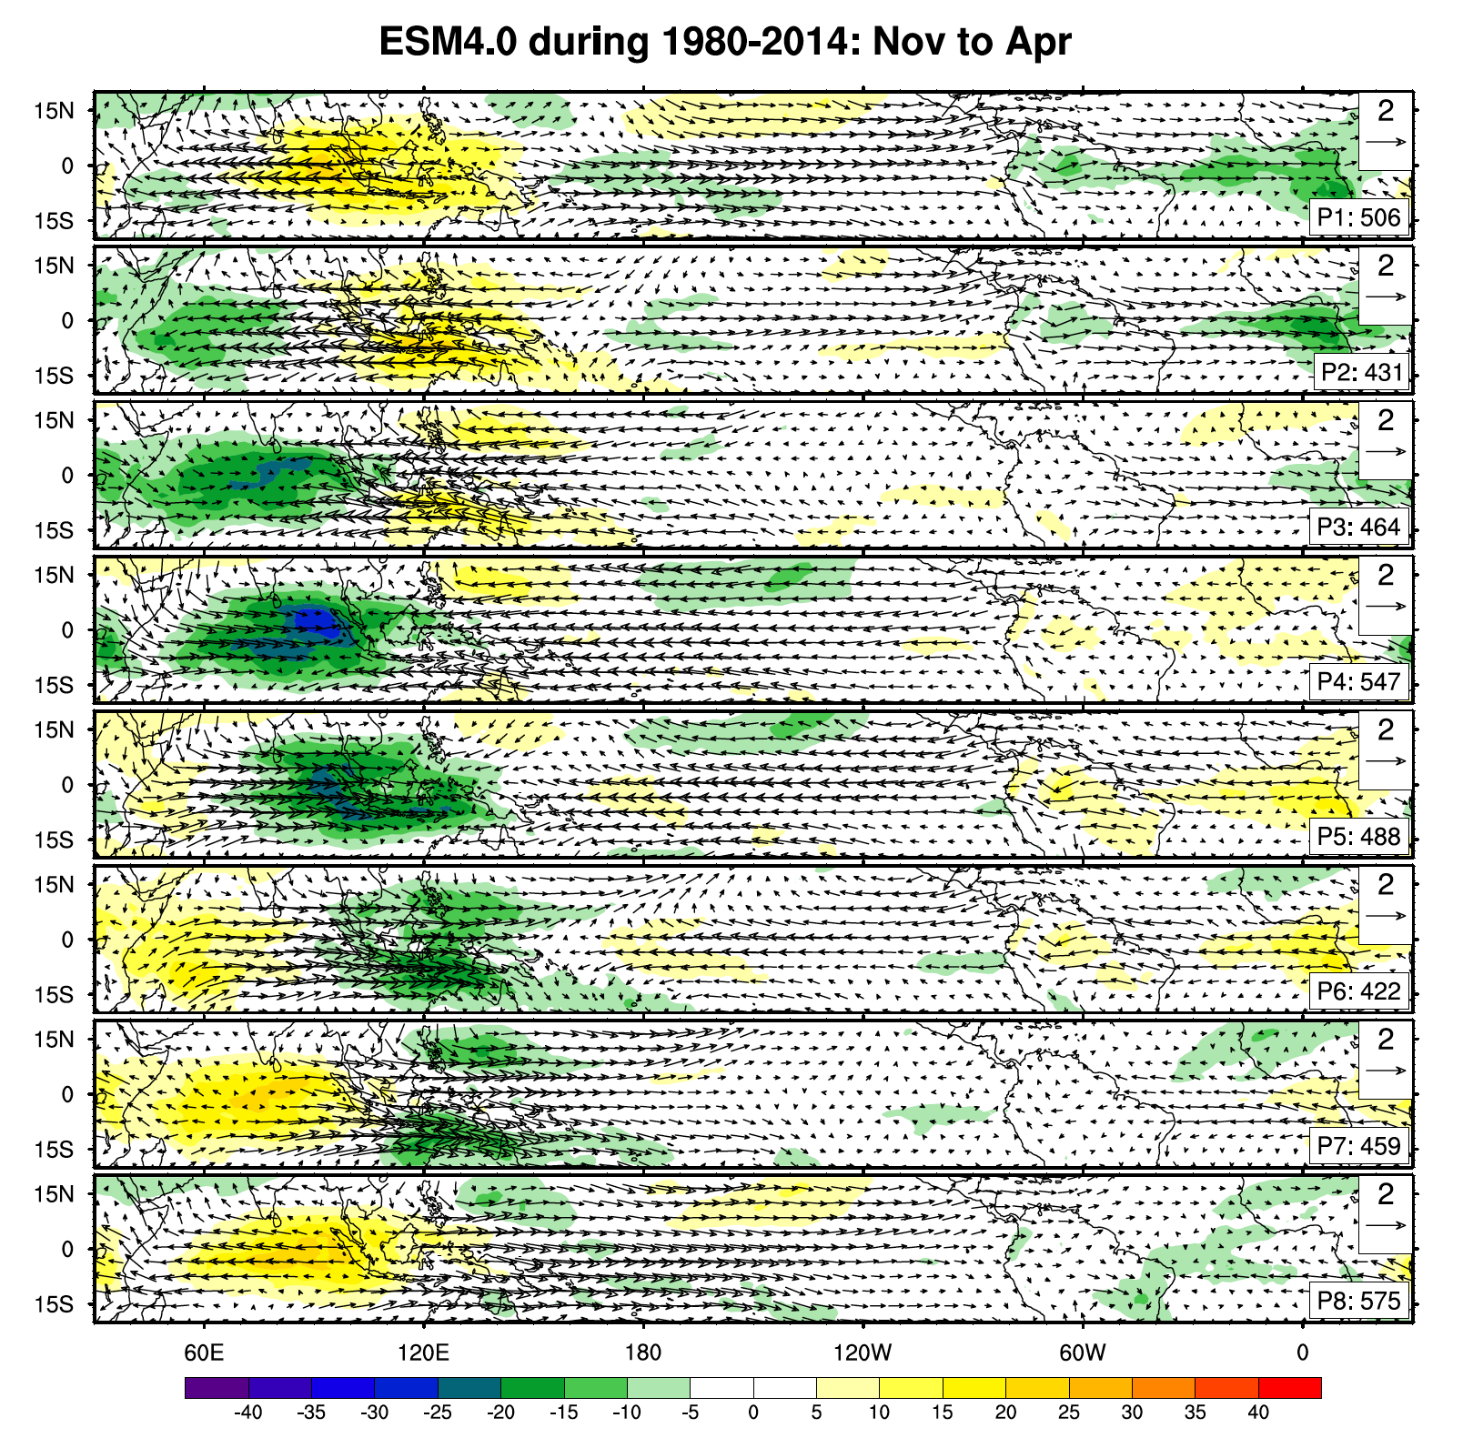
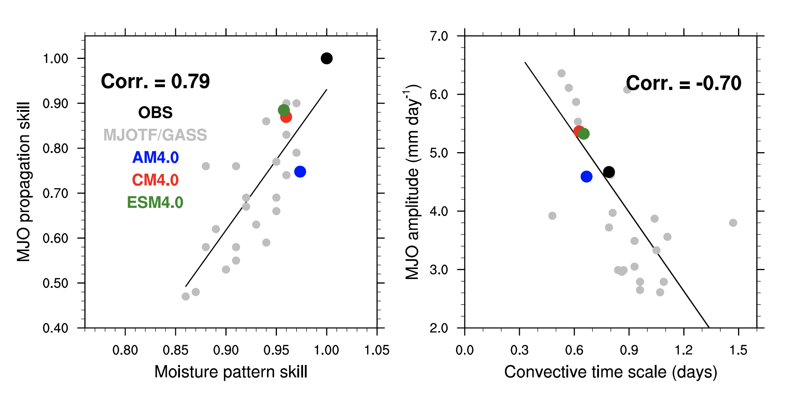
Process Oriented Diagnostics (POD)
Gonzalez, A. O., and X. Jiang (2017)https://doi.org/10.1002/2016GL072430.
OBS
GFDL-AM4
GFDL-ESM4
Ref. Dong, 2021, UFS webinar, CMIP6 datasets from ESGF.
MJO lifecycle
Maritime continent moisture pattern skill is correlated with MJO propagation skill; Convective timescale is correlated with MJO amplitude.
Why does the model behave a certain way?
Deep-dive into the processes, emergent behaviors..
Learn, share, improve
Acknowledging the Climate and Forecast conventions, A.Radhakrishnan et al AGU 2023
7
Notes:
The seasonal mean lower level moisture pattern over the MC is a useful diagnostic metric to evaluate MJO propagation in climate models
However, global models continue to suffer from important and often common biases that impact their ability to provide reliable representations of weather and future climate. These include biases in the cold tongue and intertropical convergence zone regions (e.g., Li and Xie 2014; Grose et al. 2014), the structure of El Niño–Southern Oscillation (ENSO) ..
Traditionally, diagnostics for climate models are based on monthly mean statistics and climatologies.
For a simple example: cloud radiative effects at the top of the atmosphere are a nonunique function of cloud microphysical properties (drop number and liquid water path). Thus, constraining radiative effects of clouds is better done in conjunc-tion with detailed observations of cloud microphysics than with just radiative fluxes.
Allison
Tropical cyclone intensification processes are explored in six high-resolution climate models. The analysis framework employs process-oriented diagnostics that focus on how convection, moisture, clouds, and related processes are coupled. These diagnostics include budgets of column moist static energy and the spatial variance of column moist static energy, where the column integral is performed between fixed pressure levels. The latter allows for the quantification of the different feedback processes responsible for the amplification of moist static energy anomalies associated with the organization of convection and cyclone spinup, including surface flux feedbacks and cloud-radiative feedbacks.
Are we getting the right answer in our models for the wrong reasons? Processes can tell us that. It’s a higher level of detail

Slide 11


NOAA’s Model Diagnostics Task Force, funded by NOAA MAPP
Task Force Lead: D. Neelin (UCLA)
What We Have Done:
Established community of >90 diagnosticians
Leverages CF and CMOR conventions
Built a Python-based framework
Collaboration with DOE on Earth System Metrics and Diagnostics Standards
Prepared extensive documentation & tutorials
Moved to an open-development environment
Ability to do multi-model comparisons
Robust Testing
Where We are Going:
Major “data processor” redesign for an agile framework for ALL.
Expand to more Earth system components
Explore more weather-scale phenomena
Model workflow integration
Align with GFDL/NOAA objectives while collaborating with other community partners
Connect model development efforts with expertise in the academic and private sectors to evaluate and improve model performance and process representation
A.Radhakrishnan, MDTF, WCRP OSC 2023
Acknowledging the Climate and Forecast conventions, A.Radhakrishnan et al AGU 2023
8

Slide 12
GFDL climate modeling workflow
Data/Metadata standardization efforts
Community diagnostics
GFDL user analysis suites
Community diagnostics
Usable
Climate model output
CF and Climate Model Output Rewriter (CMOR)
GFDL Model Development
Provenance
Data publication
Towards interoperable tools and research
Acknowledging the Climate and Forecast conventions, A.Radhakrishnan et al AGU 2023
9

Slide 13

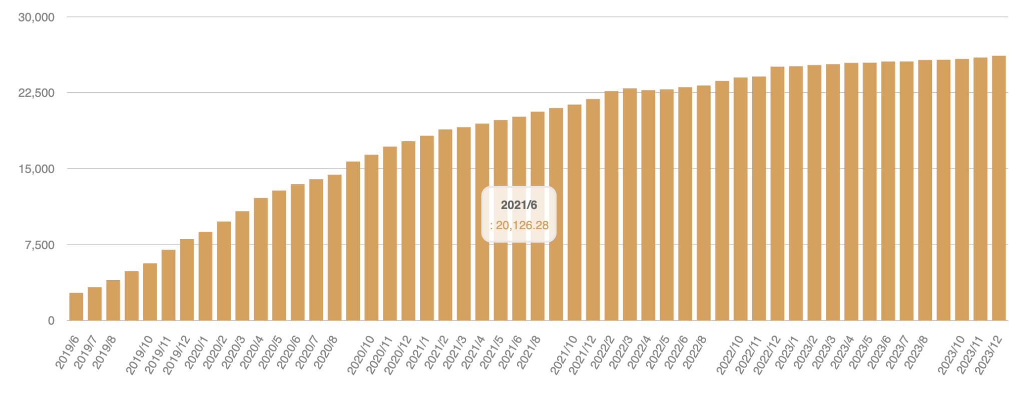
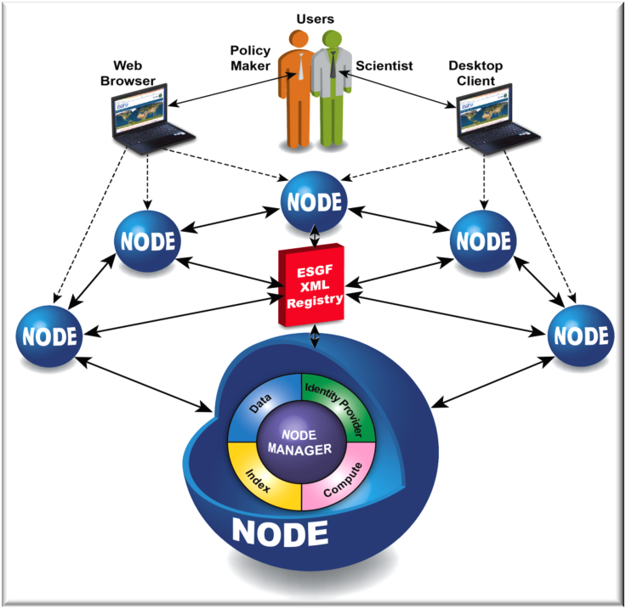

Earth System Grid Federation
>20 PB of CMIP6 data
Users
Adapted from https://esgf.github.io/
Where CMIP6 data access is made possible
Modular Infrastructure for data publication
Compliance to CF and CMOR
Towards cloud-based quality assurance
Many more..
The Earth System Grid Federation (ESGF) is an international collaboration for the software that powers most global climate change research, notably assessments by the Intergovernmental Panel on Climate Change (IPCC).
Acknowledging the Climate and Forecast conventions, A.Radhakrishnan et al AGU 2023
10
Notes:
Zonal mean temp - manabe
– How does the Earth system respond to forcing? – What are the origins and consequences of systematic model biases? – How can we assess future climate changes given internal climate vari
Figure 9: Simulations of the increase in global mean temperature from 1850-1990 due to observed increases in greenhouse gases, and predictions of the rise between 1990 and 2100 resulting from the IPCC Scenario B,C and D emissions, with the Busmess-as Usual case for comparison
Selected indicators of global climate change from CMIP6 historical and scenario simulations. (a) 4 Global surface air temperature changes relative to the 1995–2014 average (left axis) and relative to the 5 1850–1900 average (right axis; offset by 0.82°C, which is the multi-model mean and close to observed 6 best estimate, Cross-Chapter Box 2.1, Table 1)
Defn Representative Concentration Pathway (RCP) 4.5 is a scenario of long-term, global emissions of greenhouse gases, short-lived species, and land-use-land- cover which stabilizes radiative forcing at 4.5 Watts per meter squared (W m- 2, approximately 650 ppm CO2-equivalent) in the year 2100 without ever.
Shared Socioeconomic Pathways (SSPs) are scenarios of projected socioeconomic global changes up to 2100. They are used to derive greenhouse gas emissions scenarios with different climate policies.
https://www.nature.com/articles/d41586-021-02179-1

Slide 14
GFDL climate modeling workflow
Data/Metadata standardization efforts
Community diagnostics
GFDL user analysis suites
Community diagnostics
Usable
Climate model output
CF and Climate Model Output Rewriter (CMOR)
GFDL Model Development
Provenance
Data publication
Towards interoperable tools and research
Acknowledging the Climate and Forecast conventions, A.Radhakrishnan et al AGU 2023
11

Slide 15
Usable data?
Bringing analysis to the data!
Intuitive Data exploration
Analysis-ready [Cloud-optimized] Datasets! (ARCO)
Scalable analytics
Diverse audience, diverse stakeholders
Acknowledging the Climate and Forecast conventions, A.Radhakrishnan et al AGU 2023
12
Notes:
Update catalog

Slide 16

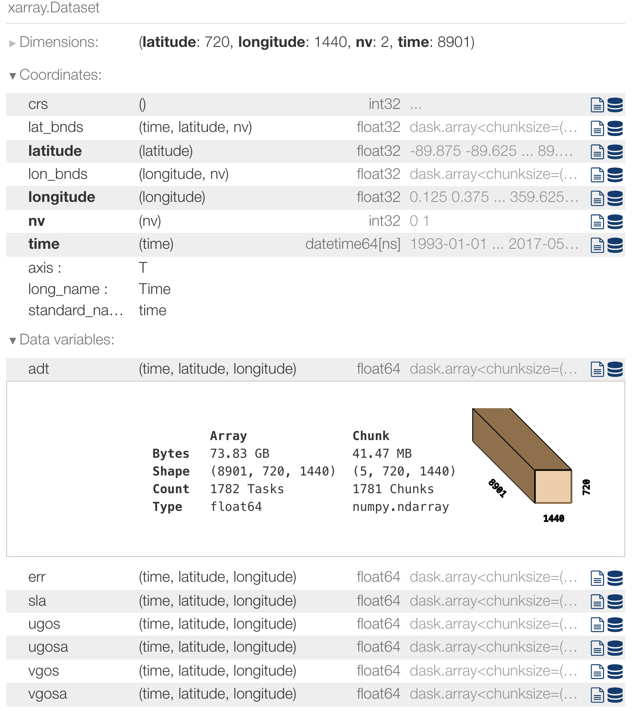


Analysis-Ready, Cloud-Optimized Data (ARCO)
Preprocess to clean
the data inline to make intercomparison seamless
Easy ARCO data
generation
Acknowledging the Climate and Forecast conventions, A.Radhakrishnan et al AGU 2023
13
Notes:
The flexibility created by "separation of storage and compute" - there can be one copy of the data and many, many different approaches to computing over it. The data provider can support data-proximate computing without actually becoming a compute provider as well

Slide 17
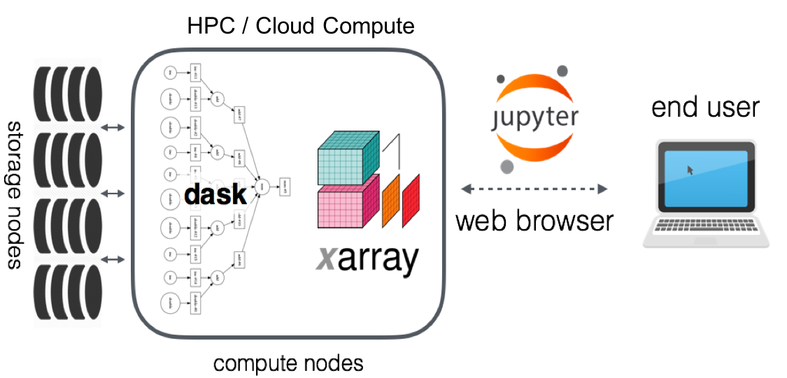


A cloud-native scientific data analytics ecosystem
Data catalogs
One copy of data and MANY ways to analyze by MANY DIFFERENT people
Data proximate analysis
Acknowledging the Climate and Forecast conventions, A.Radhakrishnan et al AGU 2023
14
Notes:
The flexibility created by "separation of storage and compute" - there can be one copy of the data and many, many different approaches to computing over it. The data provider can support data-proximate computing without actually becoming a compute provider as well

Slide 18

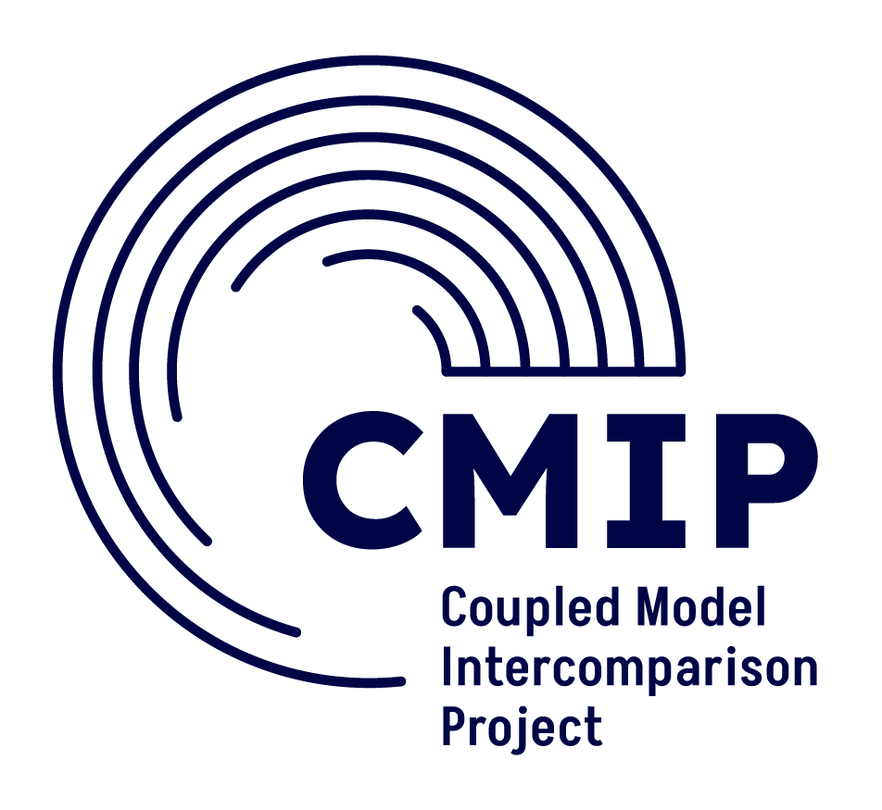


References
Contact:
aparna.radhakrishnan@princeton.edu
xMIP https://cmip6-preprocessing.readthedocs.io/en/latest/?badge=latest
CMIP6 Controlled Vocabulary https://github.com/WCRP-CMIP/CMIP6_CVs
Pangeo and data catalogs
https://pangeo-data.github.io/pangeo-cmip6-cloud/
intake-esm https://intake-esm.readthedocs.io/en/latest/
Intake-esgf https://github.com/ESGF2-US/intake-esgf
MDTF https://github.com/NOAA-GFDL/MDTF-diagnostics
How to request for additional CMIP6 data in the cloud?
https://pangeo-data.github.io/pangeo-cmip6-cloud/requesting_data.html
Acknowledging the Climate and Forecast conventions, A.Radhakrishnan et al AGU 2023
15

